Slide 1
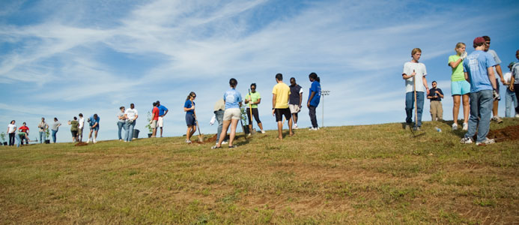
GIVE Center Volunteer Matching
David Bartz
Karen Gilmer
Ian Stewart
CSCI 4320

Slide 2
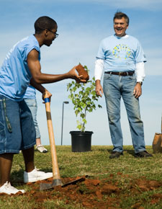
The GIVE Center:
The GIVE Center works with
numerous programs & agencies to
place GCSU students as volunteers
on and around campus.
Students who come into the GIVE Center to volunteer are suggested various programs based on their interests.

Slide 3
The GIVE Center: The problem
How to determine where a student volunteers?
Student talks to GIVE staff member
Staff members suggest program
No “official” list – suggests from memory
Programs or agencies may be forgotten
Student may not get all information

Slide 4
The GIVE Center: Our Solution
Create a database for programs & agencies
Search through database by “interests”
“Interests” – category of volunteering
Create a website
Staff & students can search & browse
Admin staff can update database

Slide 5
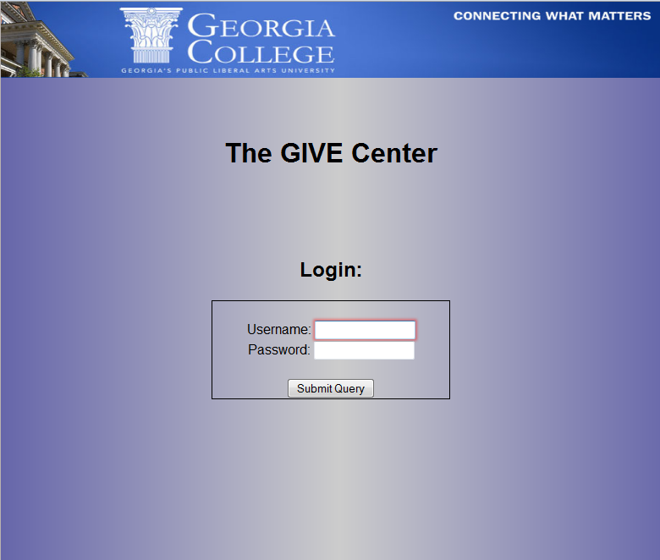
Login:
Admin
Guest

Slide 6
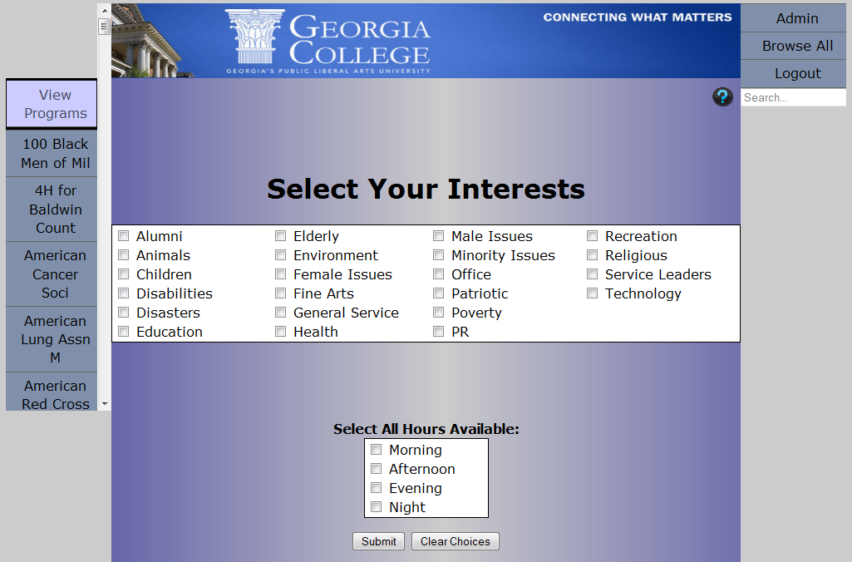
The Homepage:

Slide 7
The Homepage:
Banner

Slide 8
The Homepage:
Banner
Toggle

Slide 9
The Homepage:
Banner
Toggle
Programs
& Agencies

Slide 10
The Homepage:
Banner
Navigation
Toggle
Programs
& Agencies

Slide 11
The Homepage:
Banner
Admin Button
Navigation
Toggle
Programs
& Agencies

Slide 12
The Homepage:
Banner
Admin Button
Navigation
Toggle
Browse
Programs
& Agencies

Slide 13
The Homepage:
Banner
Admin Button
Navigation
Toggle
Browse
Help
Programs
& Agencies

Slide 14
The Homepage:
Banner
Admin Button
Navigation
Toggle
Browse
Help
Quick Search
Programs
& Agencies

Slide 15
The Homepage:
Banner
Admin Button
Navigation
Toggle
Browse
Help
Quick Search
Programs
& Agencies
Advanced Search

Slide 16
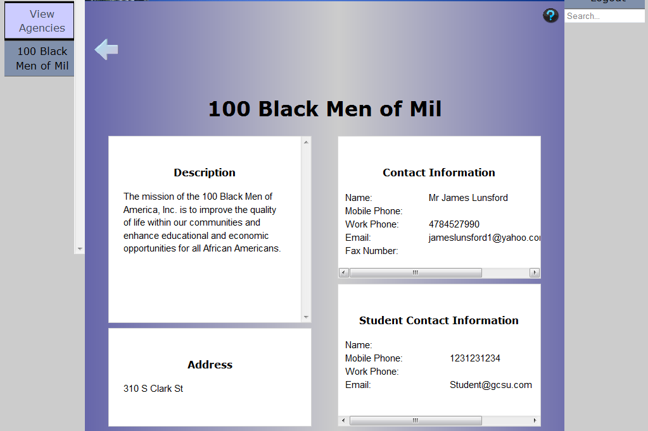
Results:
Narrowed
Programs
& Agencies

Slide 17
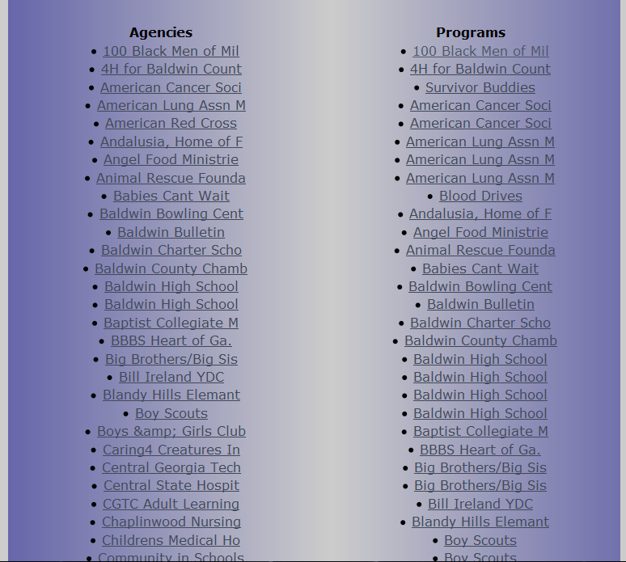
Browse All:

Slide 18
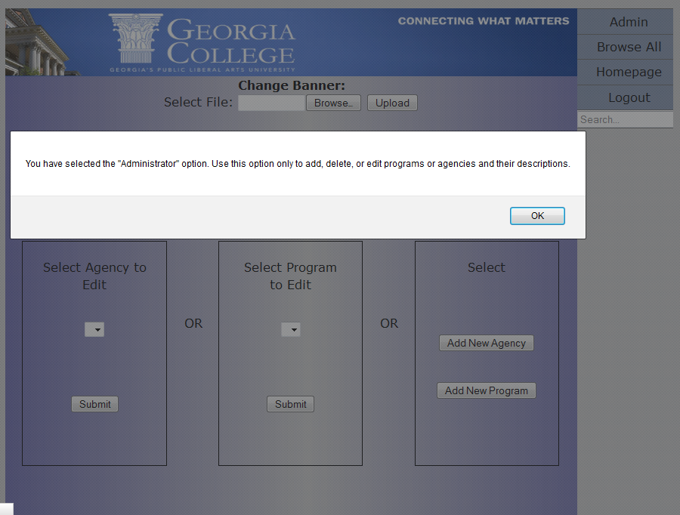
Admin:

Slide 19
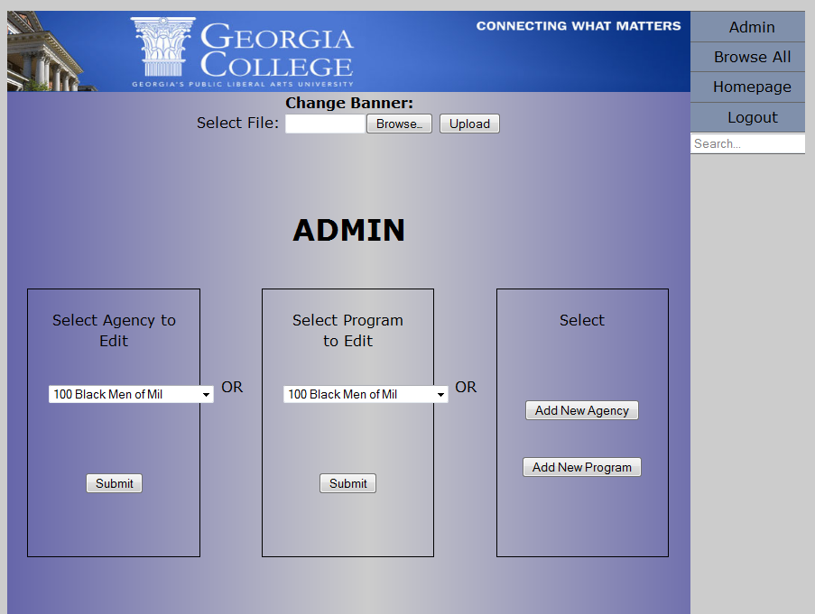
Admin:

Slide 20
Admin:
Change Banner

Slide 21
Admin:

Slide 22
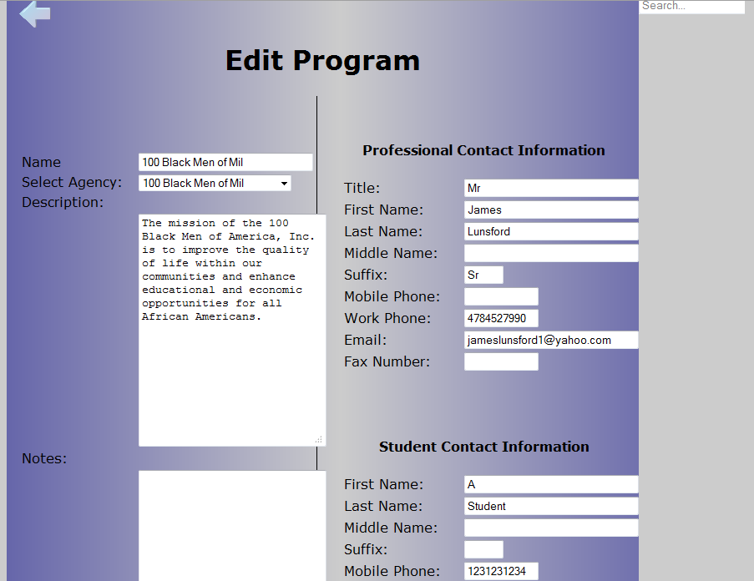
Admin: Edit a Program

Slide 23
Admin:

Slide 24
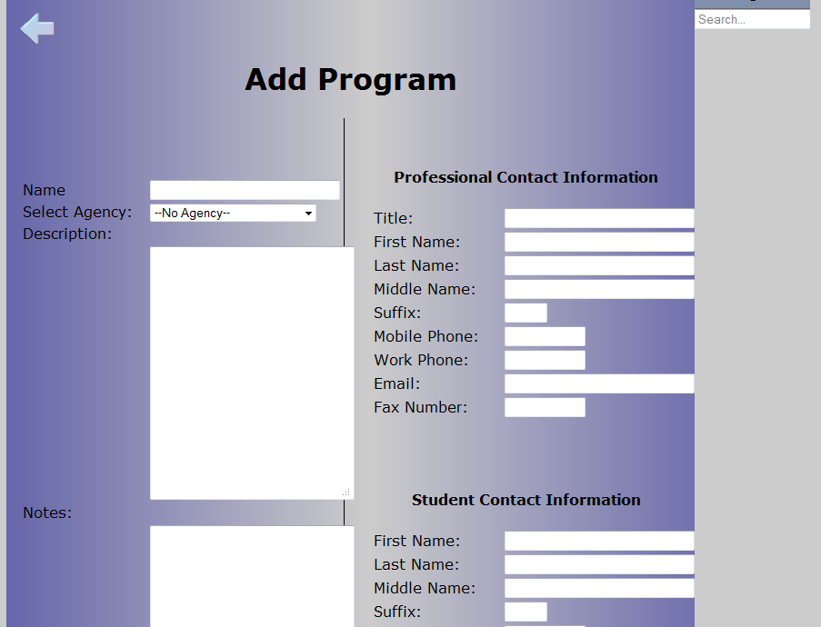
Admin: Add a Program

